Slide 1
Advance PL/SQL & UNIX

Slide 2
What to Expect from the session
After the session there will be clear understanding of below mentioned topics
Recap of key PL-SQL topics(Procedures, Functions, Packages, Exception handling)
Advanced PL/SQL topics like Cursors, Collections, Triggers, Pragma, UTL_FILE , For all, Bulk Collect
Performance Optimization of SQL Queries - Explain Plan & Costing
Unix Shell Scripting and Commonly used Commands (Find, Copy, delete etc)

Slide 3
Topics
Procedures
Parameter Modes
Functions
Packages
Exception Handling
Cursors
Collection and Pragma Autonomous transaction

Slide 4
Topics
Trigger and its Types
Bind Variable
Database Triggers
Predefined Oracle Errors
Raise Application error
Exception Propogation
UTL_FILE and shell scripting

Slide 5
Procedures
Procedures are named PL/SQL blocks.
CREATE [OR REPLACE] PROCEDURE <procedure_name> (<parameter1_name> <mode> <data type>, <parameter2_name> <mode> <data type>, ...) {AS|IS}
<Variable declarations>
BEGIN
Executable statements
[EXCEPTION
Exception handlers]
END <optional procedure name>;
Unique procedure name is required.
OR REPLACE clause facilitates testing.
Parameters are optional – enclosed in parenthesis when used.
AS or IS keyword is used – both work identically.
Procedure variables are declared prior to the BEGIN keyword.
DECLARE keyword is NOT used in named procedure.

Slide 6
Defining the IN, OUT, and IN OUT Parameter Modes
IN – This parameter type is passed to a procedure as a read-only value that cannot be changed within the procedure – this is the default mode.
OUT – This parameter type is write-only, and can only appear on the left side of an assignment statement in the procedure – it is assigned an initial value of NULL.
IN OUT – This parameter type combines both IN and OUT; a parameter of this mode is passed to a procedure, and its value can be changed within the procedure.
If a procedure raises an exception, the formal parameter values are not copied back to their corresponding actual parameters.

Slide 7
Functions
CREATE [OR REPLACE] FUNCTION <function_name> (<parameter1_name> <mode> <data type>,
<parameter2_name> <mode> <data type>, ...)
RETURN <function return value data type> {AS|IS}
<Variable declarations>
BEGIN
Executable Commands
RETURN (return_value);
. . .
[EXCEPTION
Exception handlers]
END;
A stored function (also called a user function or user-defined function) is a set of PL/SQL statements you can call by name. Stored functions are very similar to procedures, except that a function returns a value to the environment in which it is called. User functions can be used as part of a SQL expression.

Slide 8
Packages
A package is a collection of PL/SQL objects grouped together under one package name.
Packages provide a means to collect related procedures, functions, cursors, declarations, types, and variables into a single, named database object that is more flexible than the related database objects are by themselves.
Package variables – can be referenced in any procedure, function, (other object) defined within a package.
A package consists of a package specification and a package body

Slide 9
Package Specification
CREATE [OR REPLACE PACKAGE[ <package name> {AS|IS}
<variable declarations>;
<cursor declarations>;
<procedure and function declarations>;
END <package name>;
The package specification, also called the package header.
Declares global variables, cursors, exceptions, procedures, and functions that can be called or accessed by other program units.
A package specification must be a uniquely named database object.

Slide 10
Package Body
CREATE [OR REPLACE] PACKAGE BODY <package name> AS
<cursor specifications>
<subprogram specifications and code>
END <package name>;
Any subprograms declared in a package must be coded completely in the package body. The procedure and function specifications of the package body must match the package declarations including subprogram names, parameter names, and parameter modes.
Contains the code for the subprograms and other constructs, such as exceptions, declared in the package specification.

Slide 11
Cursors
Work area in which SQL statement is processed
Implicit cursor – declared automatically for DML and SELECT statements
Explicit cursor – declared and managed programmatically to handle a set of rows returned by a SELECT statement
Cursor variable – reference or pointer to a work area or cursor

Slide 12
Cursors Attributes
Attribute Name
Data
type
Description
%ROWCOUNT
Number
Number of rows affected by the SQL statement
%FOUND
Boolean
TRUE if at least one row is affected by the SQL statement, otherwise FALSE
%NOTFOUND
Boolean
TRUE if no rows are affected by the SQL statement, otherwise FALSE

Slide 13
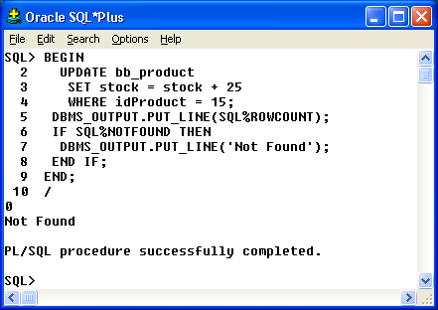
Implicit Cursor

Slide 14
Explicit Cursor
Step
Step Activity
Activity Description
1
DECLARE
Creates a named cursor identified by a SELECT statement. The SELECT statement does not include an INTO clause. Values in the cursor are moved to PL/SQL variables with the FETCH step.
2
OPEN
Processes the query and creates the active set of rows available in the cursor.
3
FETCH
Retrieves a row from the cursor into block variables. Each consecutive FETCH issued will retrieve the next row in the cursor until all rows have been retrieved.
4
CLOSE
Clears the active set of rows and frees the memory area used for the cursor.

Slide 15
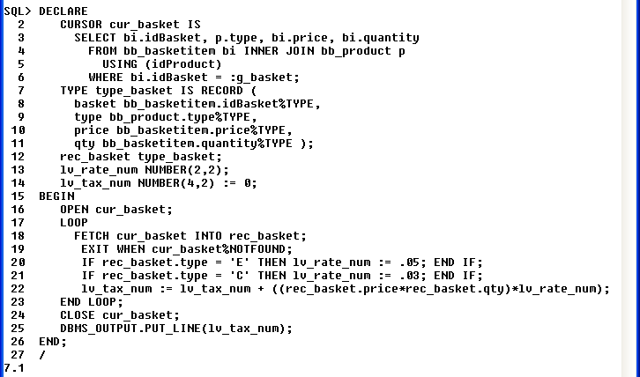
Explicit Cursor Example

Slide 16
Cursor FOR LOOP
Handles tasks automatically for processing each row returned by a cursor (record declaration, fetch, ending loop)
Use FOR UPDATE and WHERE CURRENT OF clauses for record locking

Slide 17
Cursor FOR LOOP Example
DECLARE
CURSOR cur_prod IS
SELECT type, price
FROM bb_product
WHERE active = 1
FOR UPDATE NOWAIT;
lv_sale bb_product.saleprice%TYPE;
BEGIN
FOR rec_prod IN cur_prod LOOP
IF rec_prod.type = 'C' THEN lv_sale :=
rec_prod.price * .9;
END IF;
IF rec_prod.type = 'E' THEN lv_sale :=
rec_prod.price * .95;
END IF;
UPDATE bb_product
SET saleprice = lv_sale
WHERE CURRENT OF cur_prod;
END LOOP;
COMMIT;
END;

Slide 18
Cursor Variable(Ref Cursor)
More efficiently handles data returned by query by returning a pointer to the work area rather than the actual result set.
The same cursor variable can be used for different query statements.
DECLARE
TYPE type_curvar IS REF CURSOR;
cv_prod type_curvar;
rec_coff bb_coffee%ROWTYPE;
rec_equip bb_equip%ROWTYPE;
vv_value VARCHAR2(1) := 1 ;
BEGIN
IF vv_value = 1 THEN
OPEN cv_prod FOR SELECT * FROM bb_coffee;
FETCH cv_prod INTO rec_coff;
. . .
END IF;
IF vv_value = 2 THEN
OPEN cv_prod FOR SELECT * FROM bb_equip;
FETCH cv_prod INTO rec_equip;
. . .
END IF;
END;

Slide 19
Collection
Collection consists of one or more elements accessible through an index value.
Collections are used in some of the most important performance optimization features of PL/SQL, such as
BULK COLLECT- SELECT statements that retrieve multiple rows with a single fetch, increasing the speed of data retrieval.
FORALL- Inserts, updates, and deletes that use collections to change multiple rows of data very quickly
Table functions- PL/SQL functions that return collections and can be called in the FROM clause of a SELECT statement.

Slide 20
Pragma Autonomous transactions
Autonomous transactions allow you to leave the context of the calling transaction, perform an independent transaction, and return to the calling transaction without affecting it's state.
The autonomous transaction has no link to the calling transaction, so only commited data can be shared by both transactions.

Slide 21
Database Triggers
Database trigger – a stored PL/SQL program unit that is associated with a specific database table, or with certain view types – can also be associated with a system event such as database startup.
Triggers execute (fire) automatically for specified SQL DML operations – INSERT, UPDATE, or DELETE affecting one or more rows of a table.

Slide 22
Trigger Syntax
CREATE [OR REPLACE] TRIGGER trigger_name
{BEFORE|AFTER|INSTEAD OF} triggering_event [referencing_clause] ON {table_name | view_name}
[WHEN condition] [FOR EACH ROW]
DECLARE
Declaration statements
[BEGIN
Executable statements
EXCEPTION
Exception-handling statements]
END;

Slide 23
Database Triggers
Database triggers can be used to perform any of the following tasks:
Audit data modification.
Log events transparently.
Enforce complex business rules.
Derive column values automatically.
Implement complex security authorizations.
Maintain replicate tables.
Publish information about events for a publish-subscribe environment such as that associated with web programming.

Slide 24
Trigger Syntax
The trigger body must have at least the executable section.
The declarative and exception handling sections are optional.
When there is a declarative section, the trigger body must start with the DECLARE keyword.
The WHEN clause specifies the condition under which a trigger should fire.

Slide 25
Trigger Types
BEFORE and AFTER Triggers – trigger fires before or after the triggering event. Applies only to tables.
INSTEAD OF Trigger – trigger fires instead of the triggering event. Applies only to views.
Triggering_event – a DML statement issued against the table or view named in the ON clause – example: INSERT, UPDATE, or DELETE.
DML triggers are fired by DML statements and are referred to sometimes as row triggers.

Slide 26
Trigger Types
FOR EACH ROW clause – a ROW trigger that fires once for each modified row.
STATEMENT trigger – fires once for the DML statement.
Referencing_clause – enables writing code to refer to the data in the row currently being modified by a different name.

Slide 27
Bind Variables :old and :new Defined
DML Statement | :old | :new
INSERT | Undefined – all column values are NULL as there is no “old” version of the data row being inserted. | Stores the values that will be inserted into the new row for the table.
UPDATE | Stores the original values for the row being updated before the update takes place | Stores the new values for the row – values the row will contain after the update takes place.
DELETE | Stores the original values for the row being deleted before the deletion takes place. | Undefined – all column values are NULL as there will not be a “new” version of the row being deleted.

Slide 28
Example
CREATE OR REPLACE TRIGGER AuditEquipment
AFTER DELETE OR INSERT OR UPDATE ON Equipment
FOR EACH ROW
BEGIN
IF DELETING THEN
INSERT INTO equipment_audit VALUES ('DELETE', SYSDATE,
:old.EquipmentNumber, :old.Description, :old.OriginalCost,
:old.QuantityAvailable, :old.ProjectNumber);
ELSIF INSERTING THEN
INSERT INTO equipment_audit VALUES ('INSERT', SYSDATE,
:new.EquipmentNumber, :new.Description, :new.OriginalCost,
:new.QuantityAvailable, :new.ProjectNumber);
ELSE -- updating - Insert a before and after image of updates
INSERT INTO equipment_audit VALUES ('UPDATE-OLD', SYSDATE,
:old.EquipmentNumber, :old.Description, :old.OriginalCost,
:old.QuantityAvailable, :old.ProjectNumber);
INSERT INTO equipment_audit VALUES ('UPDATE-NEW', SYSDATE,
:new.EquipmentNumber, :new.Description, :new.OriginalCost,
:new.QuantityAvailable, :new.ProjectNumber);
END IF;
END;

Slide 29
Exception Handling
Used to capture error conditions and handle the processing to allow the application to continue
Placed in the EXCEPTION section of a PL/SQL block
Two types of errors
Oracle errors (Predefined and Non-Predefined)
User-defined errors
RAISE_APPLICATION_ERROR

Slide 30
Predefined Oracle Errors
Exception Name
Description
NO_DATA_FOUND
A SELECT statement in a PL/SQL block retrieves no rows or a nonexistent row of an index-by table is referenced
TOO_MANY_ROWS
A SELECT statement in a PL/SQL block retrieves more than one row
CASE_NOT_FOUND
No WHEN clause in the CASE statement is processed
ZERO_DIVIDE
Attempted division by zero
DUP_VAL_ON_INDEX
Attempted violation of a unique or primary key column constraint

Slide 31
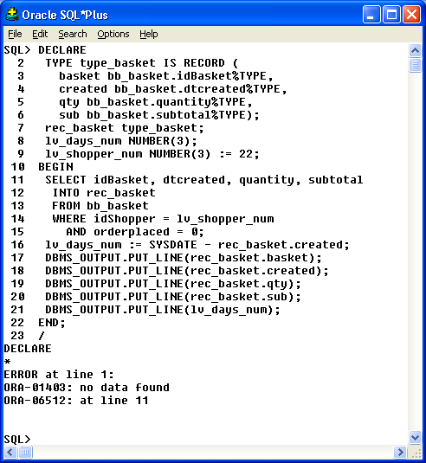
Example

Slide 32
RAISE_APPLICATION_ERROR
Allows developers to associate their own error number and message to an error

Slide 33
Exception Propagation
When an error occurs in a block, processing immediately moves to the EXCEPTION section of the block.
If the block is nested and no handlers address the error, the processing will then move to the EXCEPTION section of the enclosing block

Slide 34
UTL_FILE
UTL_FILE package lets your PL/SQL programs read and write operating system
The file I/O capabilities are similar to those of the standard operating system stream file I/O
For example ,call the FOPEN function to return a file handle,which you then use in subsequent calls to GET_LINE or put to perform I/O to a file.

Slide 35
Unix shell scripting
A shell script is a simple method of programming that enables anyone to use the power of the Unix command line.
All you need for a shell script is the following template:
#/bin/sh
Some commands
chmod
awk
grep
who
head/tail
sed
sort
date

Slide 36
Questions and Answers

